Slide 1



Apex
Project Milestone 5
CSCI 4661
Dr. Ben Samuel
Ivan Zelenkov

Slide 2
Apex Application Use Example
This application is mainly targeted to help people who work in the field of cryptocurrencies. Let's say the user just started the workday and needs to figure out how prices changed compared with yesterday, read some news, and make some important calculations of how much profit will be made after investing some amount of money. Also, the user may want to share important information with some other known users using messenger.

Slide 3
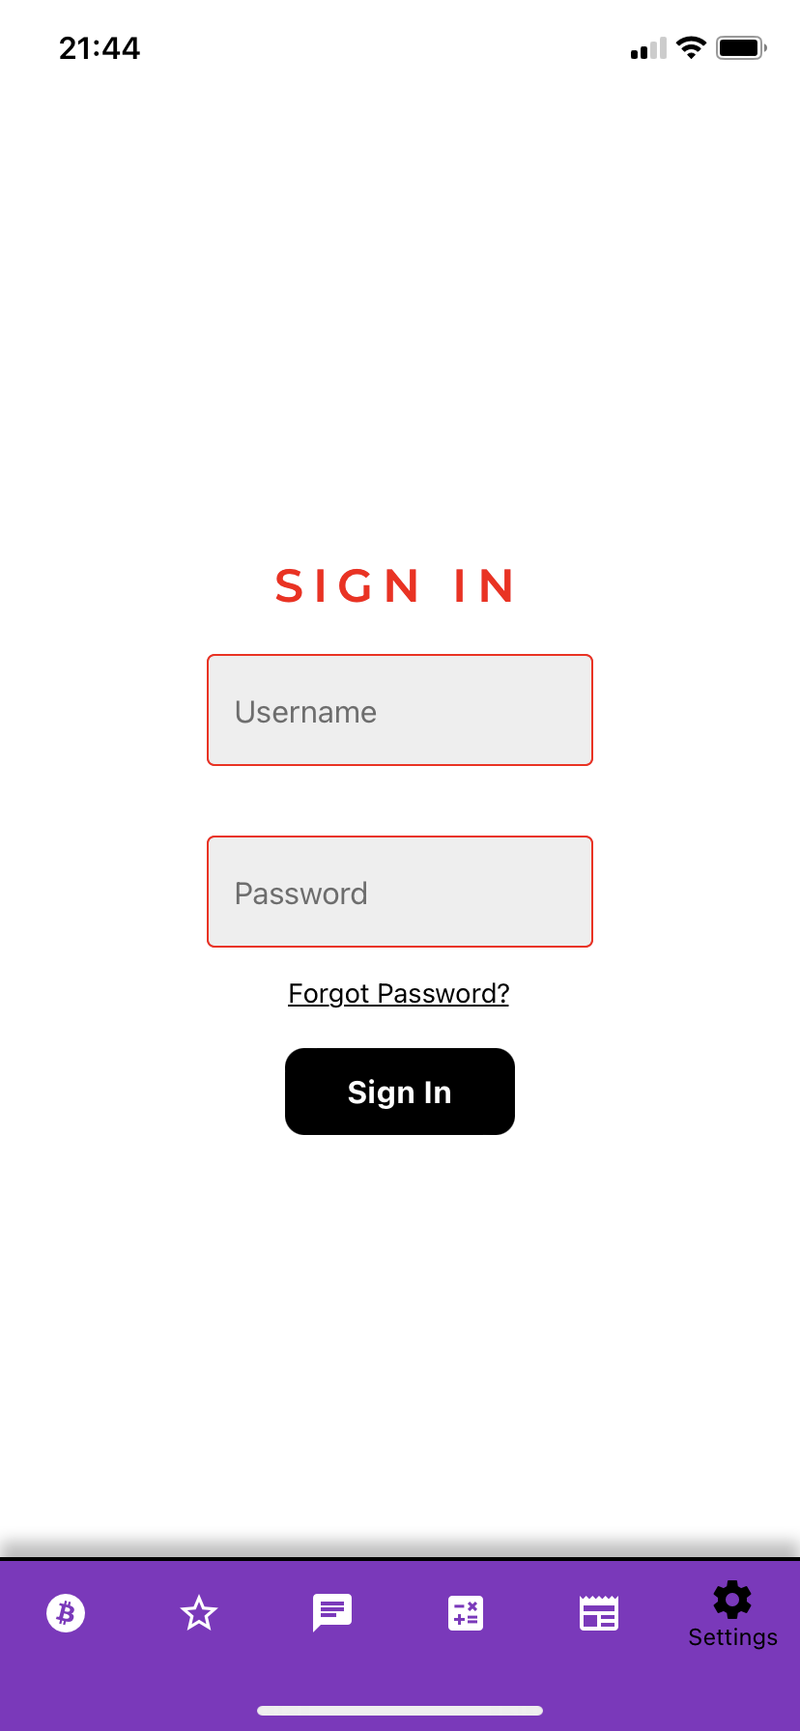
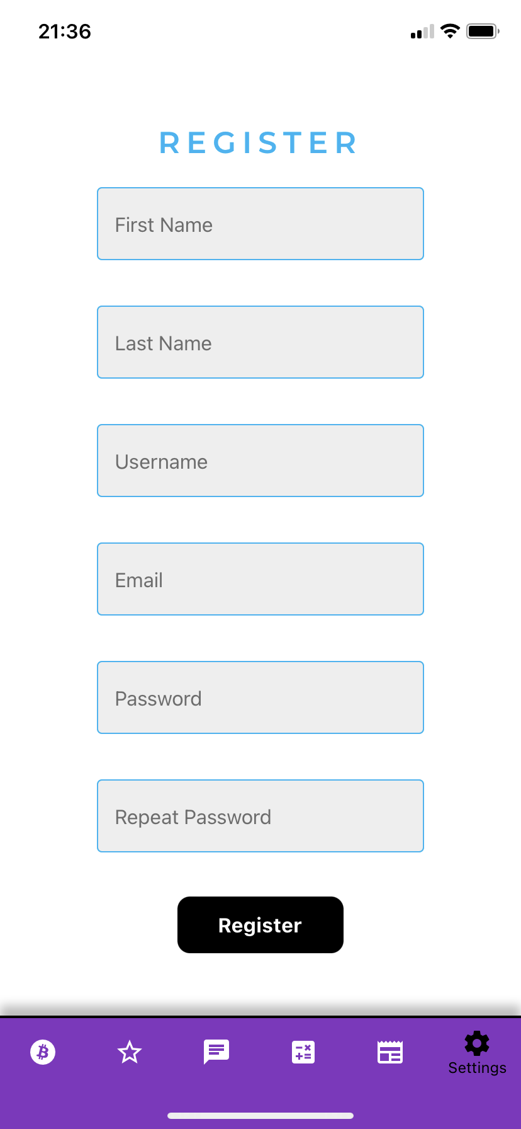
Register and Sign in screens
Everything starts from the register or sign-in screen depending on whether this user is new or not. In order to register user just will have to input 6 fields (first name, last name, username, email, password, repeat password) and submit, for signing in there should be provided a username and password. When the user finished one of those steps then everything starts from the crypto market screen.

Slide 4
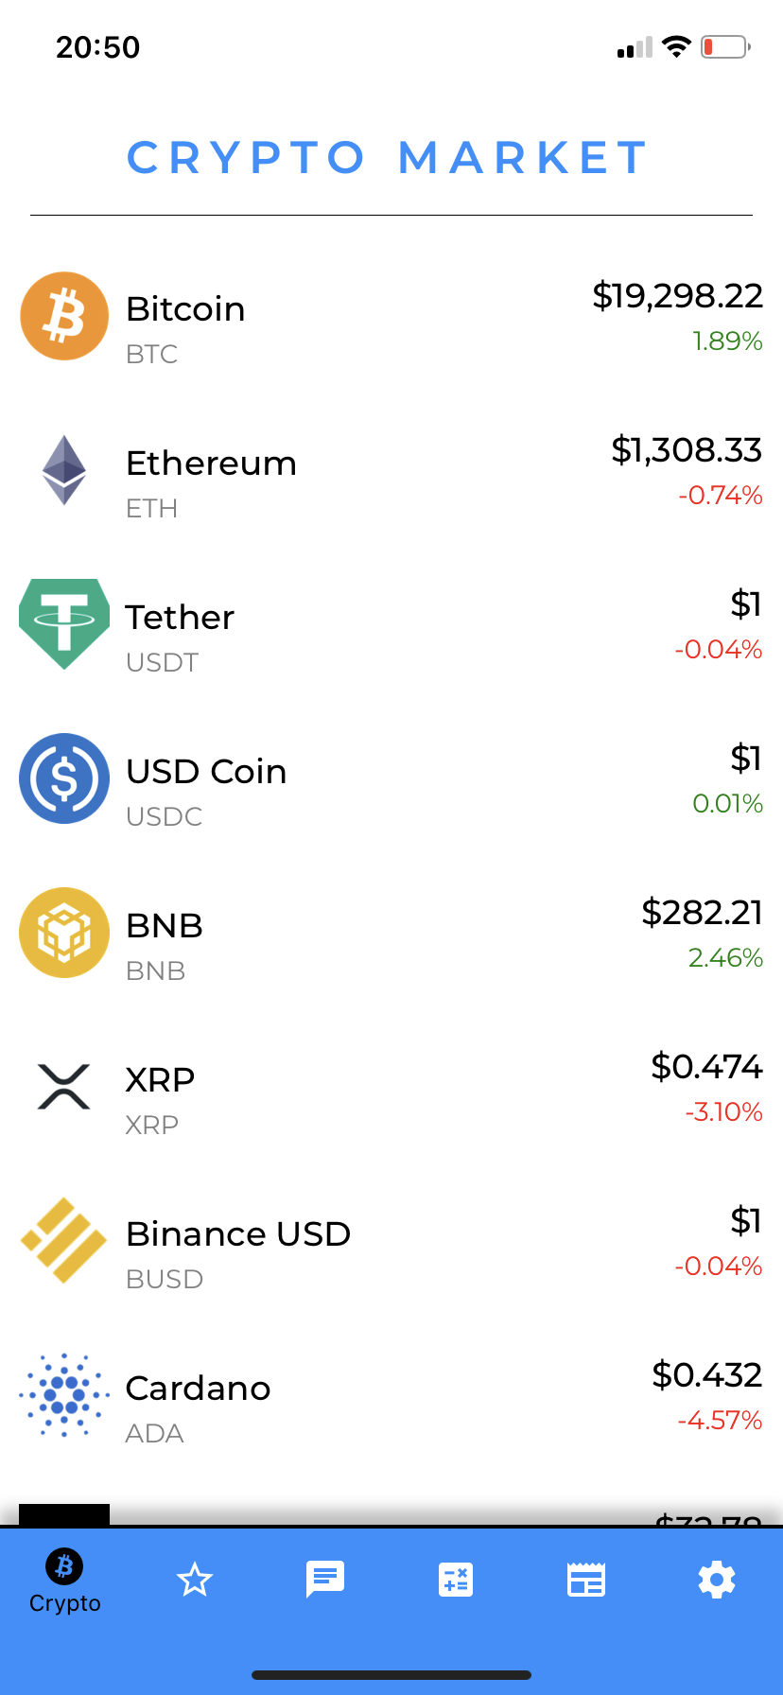
Crypto MARKET Screen
The bottom tab is providing the user with different options to navigate in the app. Users can move between Crypto, Favorite, Messenger, Calculators, News, or Settings screens.
The first thing the user will see is a long list of cryptocurrencies that can be scrolled through and explored in more detail. Each item has a current price and the percentage difference between the current cost and the previous cost at the current moment. The user will be able to scroll continuously through the screen to see more and find needed cryptos.

Slide 5
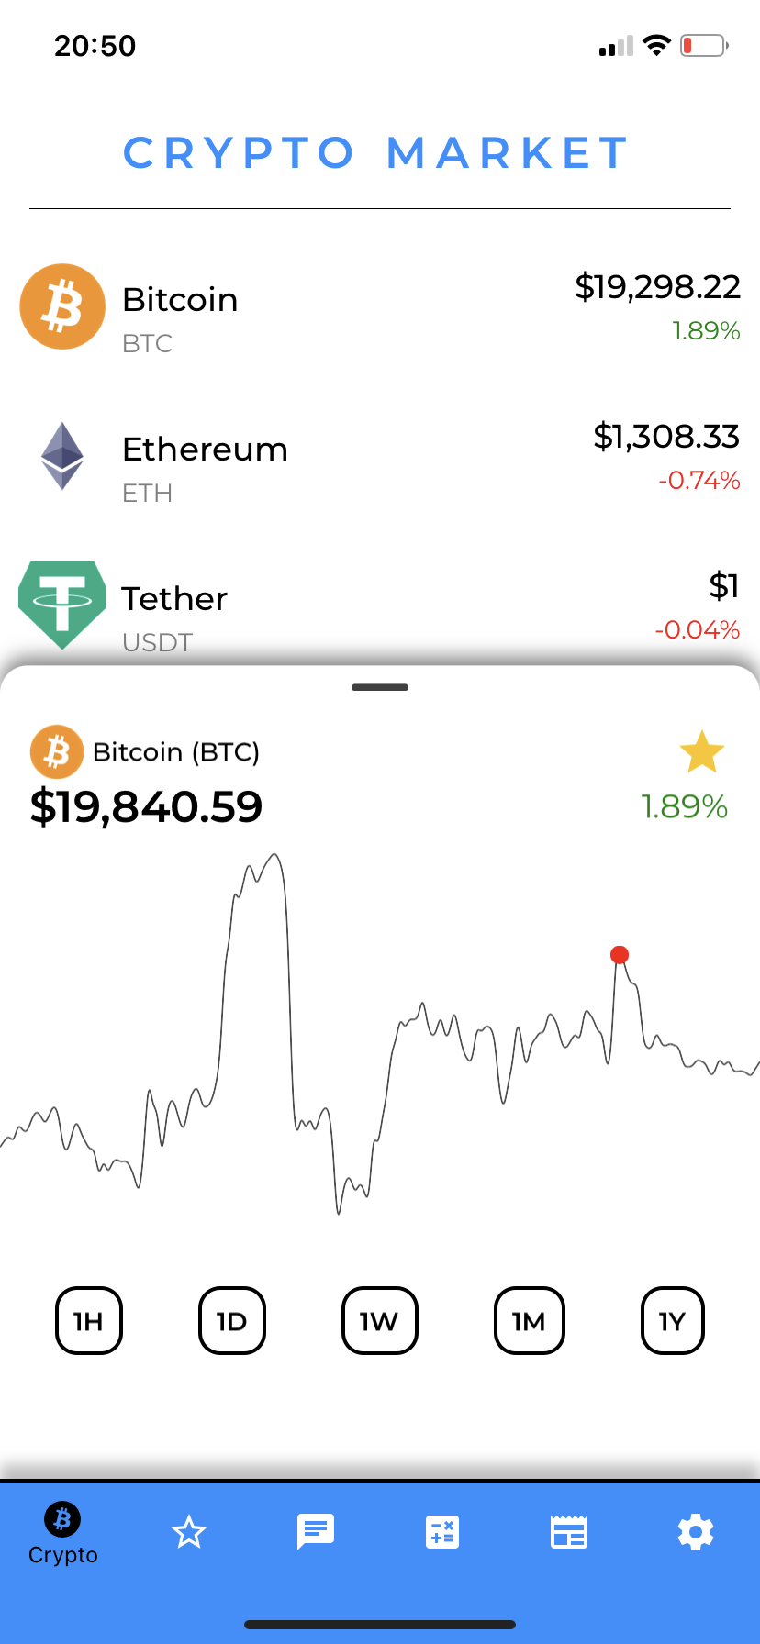
Diagram Module
Let's say that the user clicks on one of the cryptocurrencies, and the diagram module will be opened. It currently represents a diagram that displays statistics within 7 days, but it will also do the same functionality within 1 hour, 1 day, 1 month, and 1 year to provide the user with any needed data in critical situations.
The user will be also able to add the currently viewed crypto to the Favorite list. This feature will also help it easier to navigate between them next time because no need to scroll for the specific one, just add it to your favorite list and use it when needed.
The user can move the cursor over the diagram, putting a dot at a specific location. It will change the value of this cryptocurrency in the upper left corner of this module and can understand what the value of this cryptocurrency was, for example, when increased. It lets user track information in a very detailed way.
Add to the favorite list
Put the cursor and see an updated cost

Slide 6
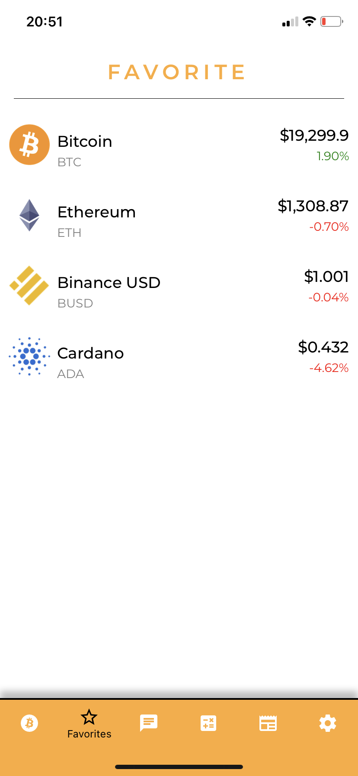
Favorite Screen
So, let's say the user at the previous step looked at 4 cryptocurrencies and would like to add them (Bitcoin, Ethereum, Binance USD, Cardano) to the favorite list. As you can see those specific cryptos are added to the favorite list. In such a way, the user does not need to scroll every time to the specific one. This feature will increase user experience with an application.
Users also will be able to look at the diagram by just clicking on one of them and fastly explore its recent changes in the market.

Slide 7
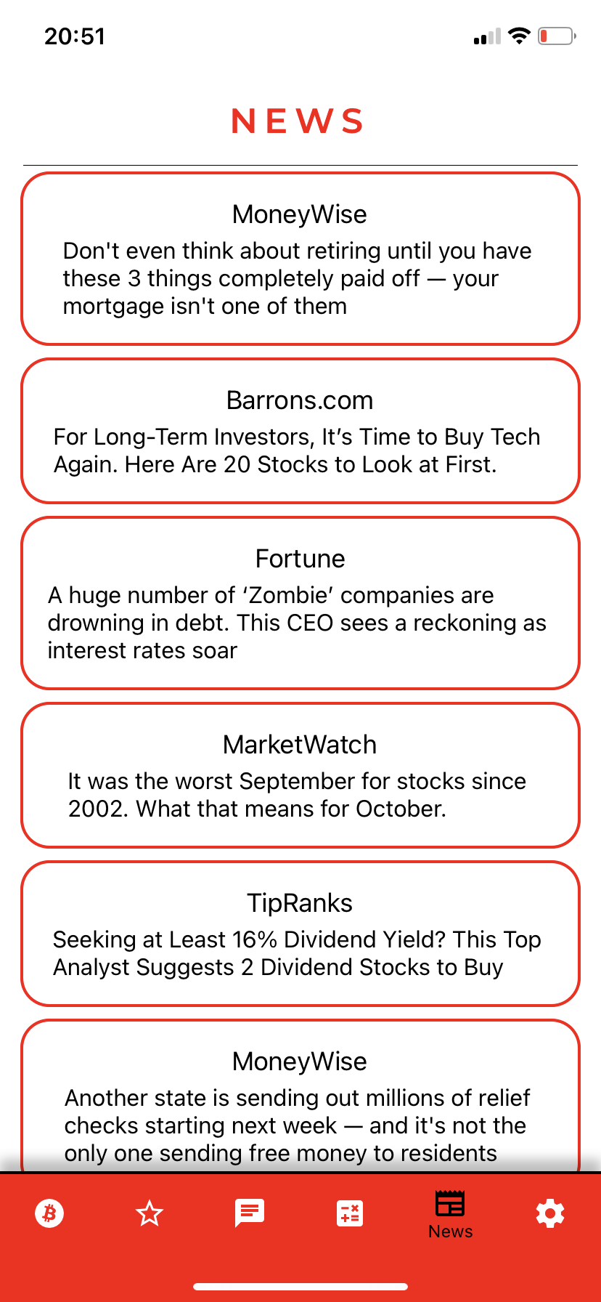
NEWS SCREEN
News Screen contains a list of popular news that is listed with title and source. Later, it will be modified, so the user can see also an image to make it more attractive.
The user can scroll and learn more about cryptocurrencies. After the user clicks one of the tabs, it will open a browser that is set by default on phone, for example, Safari, and the user can read an article in a comfortable way directly from there.

Slide 8
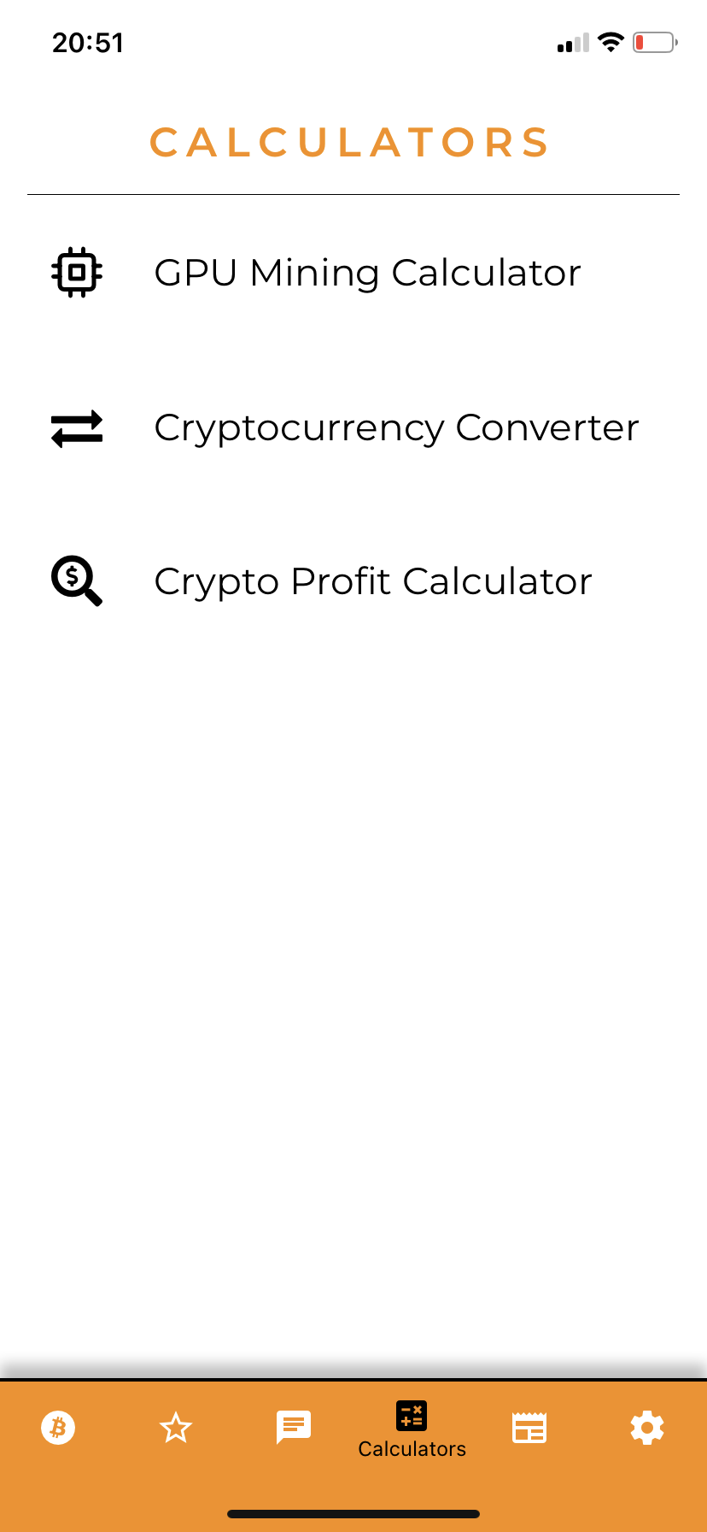
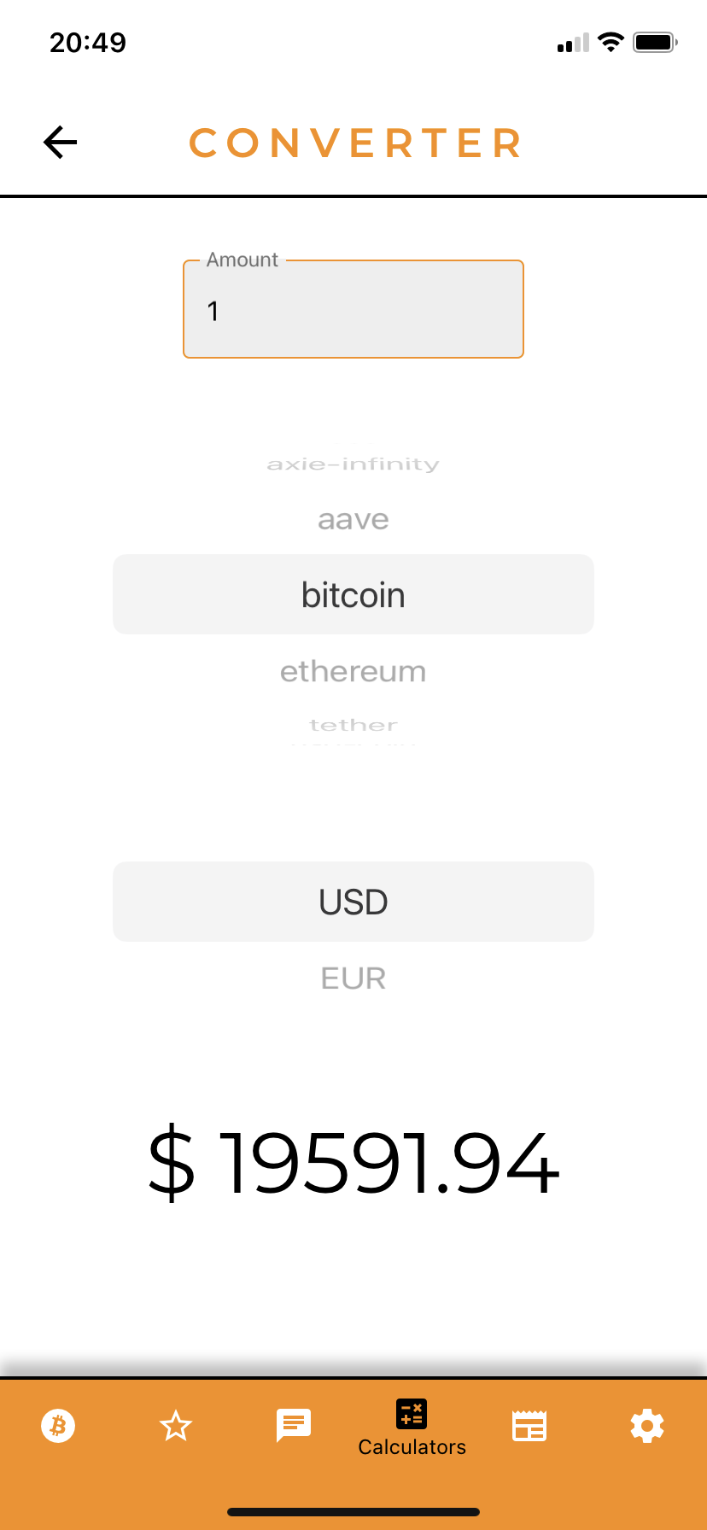
Calculators Screen
Next, what the user might do is calculate profit after investing in one of the cryptocurrencies. The user will have to provide properties like investment amount, initial crypto price, selling crypto price, and others.
The Calculators screen contains another two calculators, GPU mining for crypto miners and the converter to convert crypto to currency.
Looking at the converter example, we can see that it contains an input field (number of coins to convert), and two scroll boxes where the user will be able to set the properties of the conversion, and the number at the bottom is the result of the conversion.
After researching some things about what is happening on the market and making calculations, the user can message co-workers and discuss some ideas about proper investment.

Slide 9
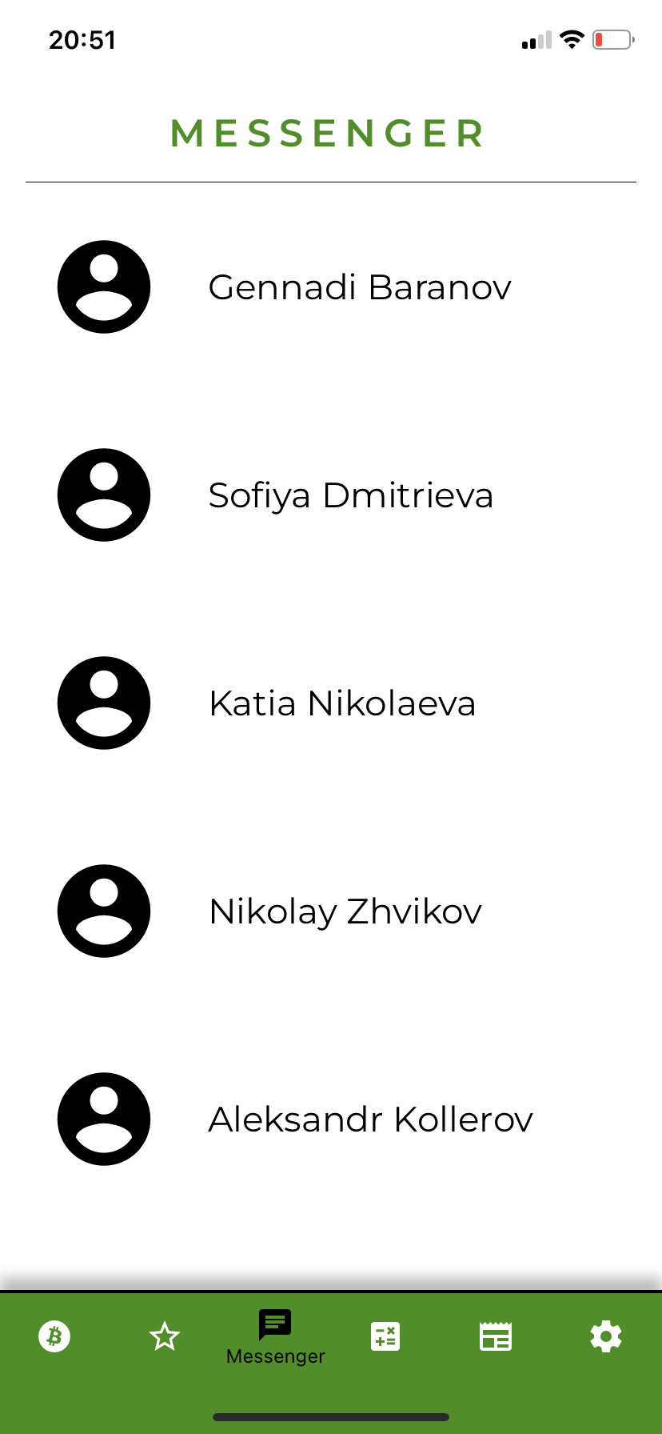
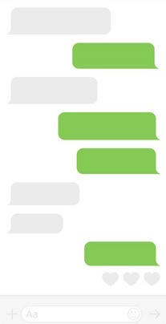
MESSENGER SCREEN
The messenger screen will contain people the user recently talked to and also a page where the conversation between two users happens. There will be basic options that every messenger should have, such as attach an image, text, or share some news with people.
This should help users to communicate with other users staying active in the same application.
Attach an image or video
Send button
Input field

Slide 10
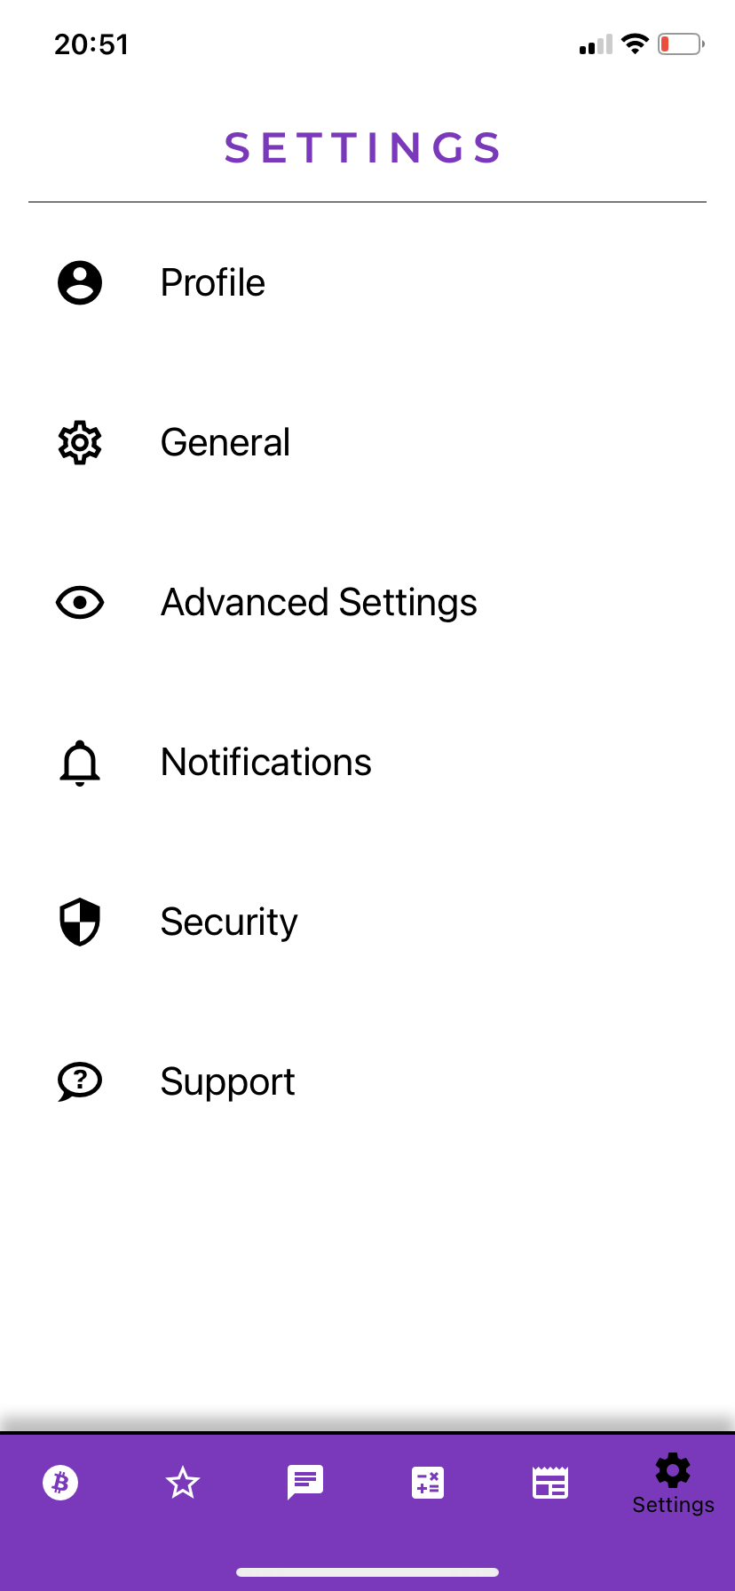
SETTINGS SCREEN
A settings screen represents different menu options. As you can see, users will be able to look at the profile page, change general settings and advanced settings, turn off or turn on the notifications, set the security settings, and the support option will provide information on how to contact the developer in case something wrong happens.

Slide 11
CONCLUSION
In conclusion, the user should benefit from this application and be able to work efficiently within a day. The user interface and functionality will be improved in the next versions, and I will keep you up to date.

Slide 12
Thank you!

